Slide 1
CAP615 PROGRAMMING IN JAVA
Presented by
Kumar Vishal

Slide 2
Array
Array is a collection of similar type of elements that have contiguous memory location.
In java, array is an object the contains elements of similar data type.
It is a data structure where we store similar elements. We can store only fixed elements in an array.
Array is index based, first element of the array is stored at 0 index.

Slide 3
Advantage of Array
Code Optimization: It makes the code optimized, we can retrieve or sort the data easily.
Random access: We can get any data located at any index position.
Disadvantage of Array
Size Limit: We can store only fixed size of elements in the array. It doesn't grow its size at runtime. To solve this problem, collection framework is used in java.

Slide 4
Types of Array: There are two types of array.
Single Dimensional Array
Multidimensional Array-
2D array
3D array
Jagged array

Slide 5
Single Dimensional Array
The syntax for declaring and instantiating an array:
There are two ways to declare an array:
type[] arrayName;
type arrayName[];

Slide 6
How to instantiate an array
arrayName = new type[length];
How to declare and instantiate an array in one statement
type[] arrayName = new type[length];

Slide 7
Examples
Array of integers
int[] num = new int[5];
Array of Strings
String[] nameList = new String[5];
nameList[0] = "Amanda Green";
nameList[1] = "Vijay Arora";
nameList[2] = "Sheila Mann";
nameList[3] = "Rohit Sharma";
nameList[4] = "Mandy Johnson";

Slide 8
Enhanced For loop
for(data_type variable : array | collection)
{
//body of for-each loop
}

Slide 9
Example:
int []myArray=new int[]{11,12,13,14,15};
for(int num : myArray)
{
System.out.println(num);
}

Slide 10
Array length
The syntax for getting the length of an array
arrayName.length
e.g-
int[] values = new int[10];
for (int i = 0; i < values.length; i++)
{
values[i] = i;
}

Slide 11
Two-dimensional arrays
The syntax for creating a rectangular array-
type[][] arrayName = new type[rowCount][columnCount];
A statement that creates a 3x2 array
int[][] numbers = new int[3][2];
3x2 array and initializes it in one statement
int[][] numbers =new int[][] { { 1, 2 }, { 3, 4 }, { 5, 6 } };

Slide 12
Enhanced for loop for 2D array
for (int[] num: arr)
{
for(int data: num)
{
System.out.println(data);
}
}

Slide 13
Jagged array
type[][] arrayName = new type[rowCount][];
e.g:-
int num[][]=new int[4][];
num[0]=new int[1];
num[1]=new int[2];
num[2]=new int[3];
num[3]=new int[4];

Slide 14
3 d array:
Syntax:
array_type[][][] array_name = new array_type[x][y][z];
Ex:
int[][][] num=new int[2][3][4];
Here, num[i][j][k] where ‘i’ is the array number, ‘j’ is the row number and ‘k’ is the column number.

Slide 15
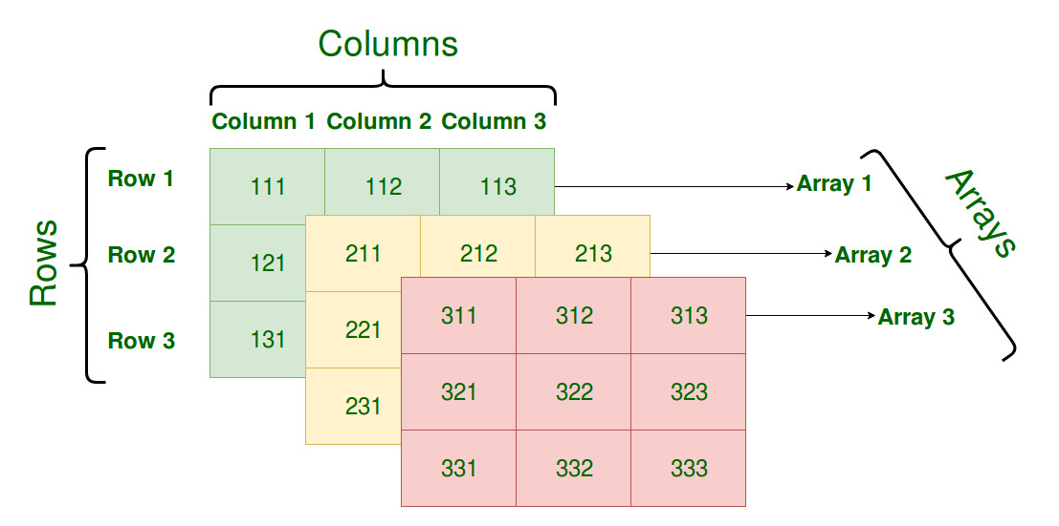
int[][][] num=new int[3][3][3];

Slide 16
For example find exam scores obtained by three students of each department in 3 different subjects.

Slide 17
To store all these exam scores, department-wise,
we will need to use three-dimensional array
int[ ][ ][ ] scores = new int[3][3][3];
Electronics department:
student1 scores: 75, 87, 69
student2 scores: 90, 87, 85
student3 scores: 56, 67, 76
Computer Science department:
student1 scores: 78, 67, 75
student2 scores: 87, 98, 76
student3 scores: 67, 56, 65
Information Technology department:
student1 scores: 72, 63, 72
student2 scores: 82, 91, 71
student3 scores: 64, 56, 66

Slide 18
4 D Array
4D:- Array of Array(Array of 3 D Array)
int [][][][] num=new int[2][2][2][2];
Multi dimensional array means array of arrays.

Slide 19
String Class
String is a sequence of characters. But in Java, string is an object that represents a sequence of characters.
The java.lang.String class is used to create a string object.
In java, String objects are immutable which means a constant and cannot be changed once created.

Slide 20
string is immutable in java:
public static void main(String args[]){
String s=“Kumar";
s.concat(" Vishal");
System.out.println(s);
}
Output: Kumar

Slide 21
S
Kumar
s1
Kumar Vishal
Here value not changed new object
Kumar Vishal has created

Slide 22
Why string objects are immutable in java?
Because java uses the concept of string literal. Suppose there are 5 reference variables, all refers to one object “kumar".If one reference variable changes the value of the object, it will be affected to all the reference variables. That is why string objects are immutable in java.

Slide 23
There are two ways to create String object:
By string literal
By new keyword

Slide 24
string literal
String s=“kumar";
Each time you create a string literal, the JVM checks the "string pool" first. If the string already exists in the pool, a reference to the pooled object is returned. If the string doesn't exist in the pool, a new string object is created and placed in the pool.
String s1=“kumar";
String s2=“kumar";
//It doesn't create a new string object
s1
kumar
s2
string constant pool

Slide 25
By new keyword:
String s=new String(“kumar")
In this case, JVM will create a new string object in normal (non-pool) heap memory, and the literal “kumar" will be placed in the string constant pool. The variable s will refer to the object in a heap (non-pool).

Slide 26
Concept:---
S
String s1=“kumar”
String s2=“kumar”
String s3= “Rahul”
s1
kumar
Rahul
s2
s3
String s4=new String(“kumar”)
string pool
s1==s2 // true
s1==s3//false
s1==s4//false
s4
kumar
Heap
Note:- Here s1,s2,s3 and s4 are references of string object kumar, Rahul, kumar

Slide 27
Methods in String class:
length(),
charAt()
Substring()
concat
indexOf()
equals()
compareTo()
trim()
replace()
toUpperCase()
toLowerCase();

Slide 28
length(), charAt()
int length();
char charAt(i);
Returns the number of characters in the string
Returns the char at position i.
Character positions in strings are numbered starting from 0 – just like arrays.
Returns:
”Problem".length();
”Window".charAt (2);
7
’n'

Slide 29
Substring()
Returns a new String by finding characters from an existing String.
String subs = word.substring (i, k);
returns the substring of chars in positions from i to k-1
String subs = word.substring (i);
returns the substring from the i-th char to the end
Returns:
”television".substring (2,5);
“immutable".substring (2);
“lev"
“mutable"

Slide 30
Concatenation()
String word1 = “re”, word2 = “think”; word3 = “ing”;
int num = 2;
String result = word1.concat (word2);
//the same as word1 + word2 “rethink“

Slide 31
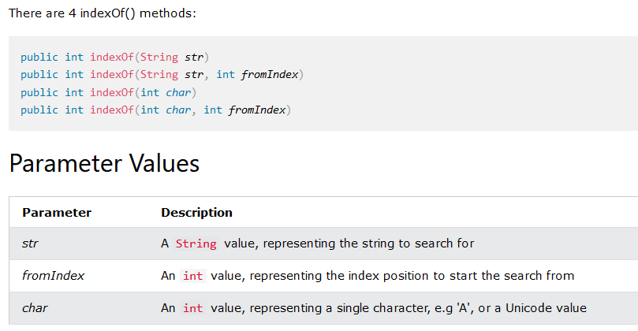
indexOf():
The indexOf() method returns the position of the first occurrence of specified character(s) in a string.

Slide 32
indexOf()
index positions
String name =“President George Washington";
name.indexOf (‘P'); 0
name.indexOf (‘e'); 2
name.indexOf (“George"); 10
name.indexOf (‘e', 3); 6
name.indexOf (“Bob"); -1
Returns:
(starts searching at position 3)
(not found)
Notes:
String has four overloaded versions of indexOf and four versions of lastIndexOf.
lastIndexOf(ch, fromPos) starts looking at fromPos and goes backward towards the beginning of the string.

Slide 33
equals()/equalsIgnoreCase()
boolean b = word1.equals(word2);
returns true if the string word1 is equal to word2
boolean b = word1.equalsIgnoreCase(word2);
returns true if the string word1 matches word2, case-blind
b = “Raiders”.equals(“Raiders”);//true
b = “Raiders”.equals(“raiders”);//false b = “Raiders”.equalsIgnoreCase(“raiders”);//true
Notes:
You cannot use relational operators for comparing the contents of strings.
word1.compareTo(word2) returns an int. Basically if word1 is “smaller” than word2, the result is negative, and if word1 is “larger” the result is positive. compareTo returns 0 whenever equals returns true.
Here is how Java docs describe compareTo:
Compares two strings lexicographically. The comparison is based on the Unicode value of each character in the strings. The character sequence represented by this String object is compared lexicographically to the character sequence represented by the argument string. The result is a negative integer if this String object lexicographically precedes the argument string. The result is a positive integer if this String object lexicographically follows the argument string. The result is zero if the strings are equal; compareTo returns 0 exactly when the equals(Object) method would return true.
This is the definition of lexicographic ordering. If two strings are different, then either they have different characters at some index that is a valid index for both strings, or their lengths are different, or both. If they have different characters at one or more index positions, let k be the smallest such index; then the string whose character at position k has the smaller value, as determined by using the < operator, lexicographically precedes the other string. In this case, compareTo returns the difference of the two character values at position k in the two string — that is, the value:
this.charAt(k)-anotherString.charAt(k)
If there is no index position at which they differ, then the shorter string lexicographically precedes the longer string. In this case, compareTo returns the difference of the lengths of the strings — that is, the value:
this.length()-anotherString.length()

Slide 34
Difference between == and .equals() method in Java
equals() is a method and == is a operator
use == operators for reference comparison (address comparison) and .equals() method for content comparison.
In simple words, == checks if both objects point to the same memory location whereas .equals() evaluates to the comparison of values in the objects

Slide 35
compareTo()
int diff = word1.compareTo(word2);
returns the “difference” word1 - word2
if string1 > string2, it returns positive number
if string1 < string2, it returns negative number
if string1 == string2, it returns 0
The java string compareTo() method compares the given string with current string . It returns positive number, negative number or 0.
It compares strings on the basis of Unicode value of each character in the strings.
Notes:
You cannot use relational operators for comparing the contents of strings.
word1.compareTo(word2) returns an int. Basically if word1 is “smaller” than word2, the result is negative, and if word1 is “larger” the result is positive. compareTo returns 0 whenever equals returns true.
Here is how Java docs describe compareTo:
Compares two strings lexicographically. The comparison is based on the Unicode value of each character in the strings. The character sequence represented by this String object is compared lexicographically to the character sequence represented by the argument string. The result is a negative integer if this String object lexicographically precedes the argument string. The result is a positive integer if this String object lexicographically follows the argument string. The result is zero if the strings are equal; compareTo returns 0 exactly when the equals(Object) method would return true.
This is the definition of lexicographic ordering. If two strings are different, then either they have different characters at some index that is a valid index for both strings, or their lengths are different, or both. If they have different characters at one or more index positions, let k be the smallest such index; then the string whose character at position k has the smaller value, as determined by using the < operator, lexicographically precedes the other string. In this case, compareTo returns the difference of the two character values at position k in the two string — that is, the value:
this.charAt(k)-anotherString.charAt(k)
If there is no index position at which they differ, then the shorter string lexicographically precedes the longer string. In this case, compareTo returns the difference of the lengths of the strings — that is, the value:
this.length()-anotherString.length()

Slide 36
Comparison Examples
//negative differences
diff = “apple”.compareTo(“berry”);//a before b
diff = “Zebra”.compareTo(“apple”);//Z before a
diff = “dig”.compareTo(“dug”);//i before u
diff = “dig”.compareTo(“digs”);//dig is shorter
//zero differences
diff = “apple”.compareTo(“apple”);//equal
diff = “dig”.compareToIgnoreCase(“DIG”);//equal
//positive differences
diff = “berry”.compareTo(“apple”);//b after a
diff = “apple”.compareTo(“Apple”);//a after A
diff = “BIT”.compareTo(“BIG”);//T after G
diff = “huge”.compareTo(“hug”);//huge is longer

Slide 37
Methods — Changing Case
String word2 = word1.toUpperCase();
String word3 = word1.toLowerCase();
returns a new string formed from word1 by converting its characters to upper (lower) case
String word1 = “HeLLo“;
String word2 = word1.toUpperCase();//”HELLO”
String word3 = word1.toLowerCase();//”hello”
Notes:
Note that these methods do not change the string word1 but create and return a new string.
trim() only removes whitespace at the ends of the string, not in the middle.

Slide 38
trim()
removing white space at both ends does not affect whites space in the middle
Example:
String word1 = “ Hi Kumar “;
String word2 = word1.trim();
//word2 is “Hi Kumar” – no spaces on either end
//word1 is still “ Hi Kumar “ – with middle spaces
Notes:
Note that these methods do not change the string word1 but create and return a new string.
trim() only removes whitespace at the ends of the string, not in the middle.

Slide 39
replace()
method returns a string replacing all the old char or CharSequence to new char or CharSequence.
Syntax:
String replace(char oldChar, char newChar)
String replace(CharSequence target, CharSequence replacement)
Example:
String str1="hello hello hello";
String str2="hello hello hello";
str1=str1.replace('h', 'H');
str2=str2.replace("hello", "hi");
System.out.println(str1);
System.out.println(str2);
Notes:
Note that these methods do not change the string word1 but create and return a new string.
trim() only removes whitespace at the ends of the string, not in the middle.

Slide 40
replaceAll()
The java string replaceAll() method returns a string replacing all the sequence of characters matching regular expression and replacement string.
Syntax:
String replaceAll(String regex, String replacement)

Slide 41
Example:
replace all occurrences of white spaces in a string:
String str = "how to do in java provides java reading materials";
String newStr = str.replaceAll(“\\s", "");
System.out.println(newStr);

Slide 42
StringBuffer class
StringBuffer is mutable means one can change the value of the object .
The object created through StringBuffer is stored in the heap .
each method in StringBuffer is synchronized that is StringBuffer is thread safe due to this it does not allow two threads to simultaneously access the same method . Each method can be accessed by one thread at a time .

Slide 43
Differences between StringBuffer and StringBuilder
StringBuffer | StringBuilder
StringBuffer is synchronized i.e. thread safe. It means two threads can't call the methods of StringBuffer simultaneously. | StringBuilder is non-synchronized i.e. not thread safe. It means two threads can call the methods of StringBuilder simultaneously.
StringBuffer is less efficient than StringBuilder. | StringBuilder is more efficient than StringBuffer.

Slide 44
methods of StringBuffer/StringBuilder class
append()
capacity()
ensureCapacity()
insert()
reverse()
replace()
length()
delete()
deleteCharAt()
substring()

Slide 45
append()
append() is used to append the string from one string to another string like concat.
Syntax:
StringBufferClassReference.append(any type)
Any type:-
append(char), append(boolean), append(int), append(float), append(double) etc.

Slide 46
capacity()
is used to return the current capacity of buffer.
The default capacity of the buffer is 16.
If the number of character increases from its current capacity, it increases the capacity by (oldcapacity*2)+2.
For example if your current capacity is 16, it will be (16*2)+2=34.

Slide 47
Condition1:
StringBuffer sb=new StringBuffer();
System.out.println("Current Capacity:"+sb.capacity());
// Current Capacity:16
Condition2:
StringBuffer sb=new StringBuffer(“hello”);
System.out.println("Current Capacity:"+sb.capacity());
// Current Capacity:21

Slide 48
ensureCapacity()
It ensures that the given capacity is the minimum to the current capacity. If it is greater than the current capacity, it increases the capacity by (oldcapacity*2)+2.
Ex:
If current capacity is:70
sb.ensureCapacity(70); // no change
But
sb.ensureCapacity(71); // cahnge now 142

Slide 49
insert(),reverse()
insert():
It is used to inserts the string at the specified position.
Syntax:
StringBufferClassReference.insert(pos,string)
reverse():
It is used to reverses the current string
Syntax:
StringBufferClassReference.reverse()

Slide 50
replace():
replaces the string from the specified startingIndex and endingIndex.
Syntax:
StringBufferClassReference.replace(startingIndex, endingIndex, newstring)
e.g:
StringBuffer sb=new StringBuffer("Hello");
sb.replace(1,3,“kumar");
System.out.println(sb);//Hkumarlo

Slide 51
length() : to find the length of current string
Syntax:
StringBufferClassReference.length()
delete(): deletes the string from the specified startingIndex to endingIndex.
Syntax:StringBufferClassReference.delete(startingIndex,endingIndex)
e.g:
StringBuffer sb=new StringBuffer("Hello");
sb.delete(1,3);
System.out.println(sb);//Hlo

Slide 52
deleteCharAt():
deletes the character at the index specified by loc.
Syntax:
StringBufferClassReference.deleteCharAt(int loc)
e.g:
StringBuffer sb=new StringBuffer("Hello");
sb.deleteCharAt(3);
System.out.println(sb);//Helo

Slide 53
substring()
substring()is used to return the substring from the specified startingIndex and endingIndex.
Syntax:
substring(int startingIndex, int endingIndex)

Slide 54
Any Query??

